Slide 1
OAK Pertemuan 7
Chapter 8
Operating System Support

Slide 2
Objectives and Functions
An OS is a program that controls the execution of application programs and acts as an interface between applications and the computer hardware.
Objectives:
  Convenience
    Making the computer easier to use
  Efficiency
    Allowing better use of computer resources

Slide 3
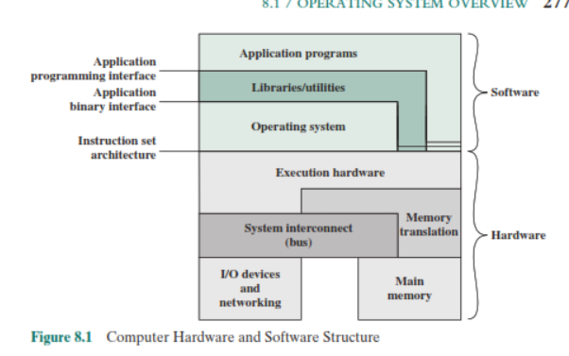
OS as interface:
Layers and Views of a Computer System

Slide 4
Operating System Services
Program creation
Program execution
Access to I/O devices
Controlled access to files
System access
Error detection and response
Accounting

Slide 5
OS as resource manager
computer is a set of resources for the movement, storage, and processing of data and for the control of these functions. The OS is responsible for managing these resources.

Slide 6
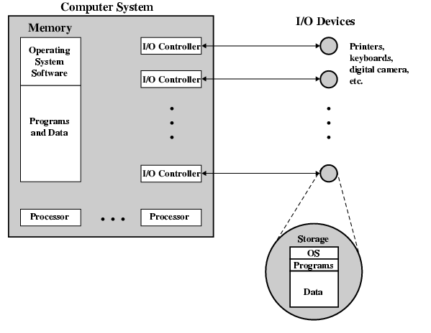
O/S as a Resource Manager

Slide 7
Types of Operating System
2 dimensions:
Interactive vs batch
  Interactive
  Batch
Single vs Multi
  Single program (Uni-programming)
  Multi-programming (Multi-tasking)

Slide 8
Early Systems
Late 1940s to mid 1950s
No Operating System
Programs interact directly with hardware
Two main problems:
  Scheduling
  Setup time

Slide 9
Simple Batch Systems
Resident Monitor program
Users submit jobs to operator
Operator batches jobs
Monitor controls sequence of events to process batch
When one job is finished, control returns to Monitor which reads next job
Monitor handles scheduling

Slide 10
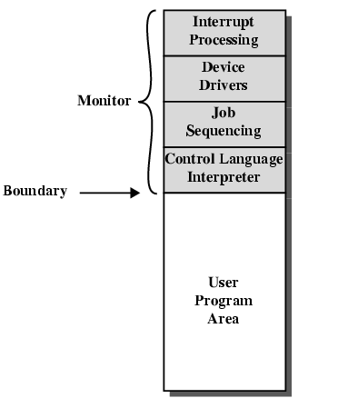
Memory Layout for Resident Monitor

Slide 11
Job Control Language
Instructions to Monitor
Usually denoted by $
e.g.
  $JOB
  $FTN
  ... Some Fortran instructions
  $LOAD
  $RUN
  ... Some data
  $END

Slide 12
Desirable Hardware Features from Monitor
Memory protection
  To protect the Monitor
Timer
  To prevent a job monopolizing the system
Privileged instructions
  Only executed by Monitor
  e.g. I/O
Interrupts
  Allows for relinquishing and regaining control

Slide 13
Multi-programmed Batch Systems
I/O devices very slow
When one program is waiting for I/O, another can use the CPU

Slide 14
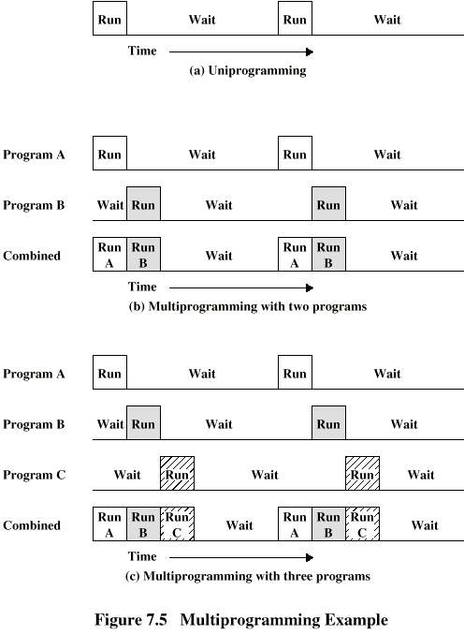
Single Program

Slide 15
Multi-Programming with
Two Programs

Slide 16
Multi-Programming with
Three Programs

Slide 17
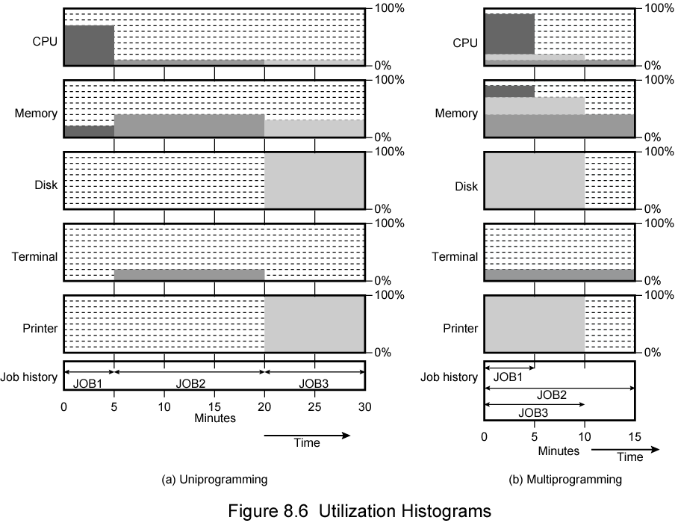
Utilization

Slide 18
Time Sharing Systems
Allow users to interact directly with the computer
  i.e. Interactive
Multi-programming allows a number of users to interact with the computer

Slide 19
Scheduling
Key to multi-programming
type
  Long term
  Medium term
  Short term
  I/O

Slide 20
Long Term Scheduling
Determines which programs are submitted for processing
i.e. controls the degree of multi-programming
Once submitted, a job becomes a process for the short term scheduler
(or it becomes a swapped out job for the medium term scheduler)

Slide 21
Medium Term Scheduling
Part of the swapping function
Usually based on the need to manage multi-programming
If no virtual memory, memory management is also an issue

Slide 22
Short Term Scheduler
Dispatcher
Fine grained decisions of which job to execute next
i.e. which job actually gets to use the processor in the next time slot

Slide 23
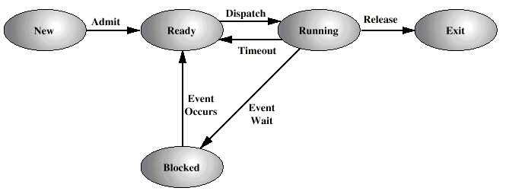
Five State Process Model

Slide 24
New: A program is admitted by the high- level scheduler but is not yet ready to execute. The OS will initialize the process, moving it to the ready state.
Ready: The process is ready to execute and is awaiting access to the processor.
Running: The process is being executed by the processor.
Waiting: The process is suspended from execution waiting for some system resource, such as I/O.
Halted: The process has terminated and will be destroyed by the OS

Slide 25
Process Control Block
Identifier
State
Priority
Program counter:The address of the next instruction in the program to be
executed.
Memory pointers: The starting and ending locations of the process in memory.
Context data: data that are present in registers in the processor
while the process is executing
I/O status: Includes outstanding I/O requests, I/O devices (e.g., tape drives) assigned to this process, a list of files assigned to the process, and so on.
Accounting information: May include the amount of processor time and clock time used, time limits, account numbers, and so on.

Slide 26
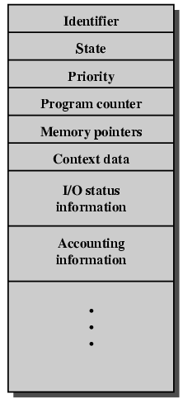
PCB Diagram

Slide 27
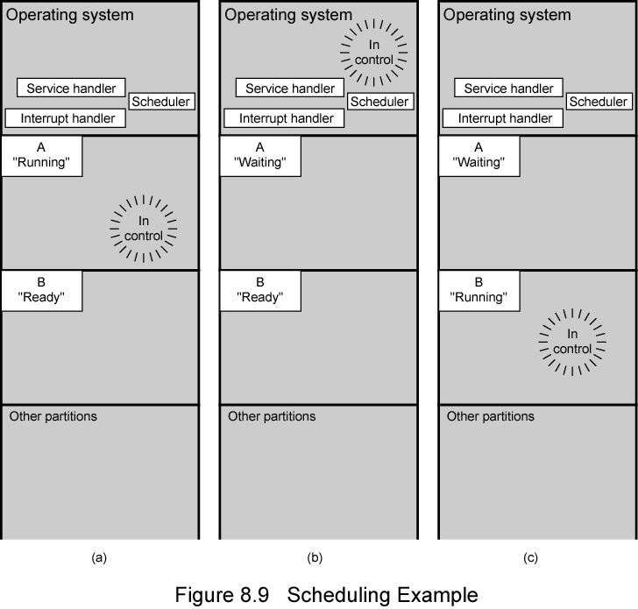
Scheduling Example

Slide 28
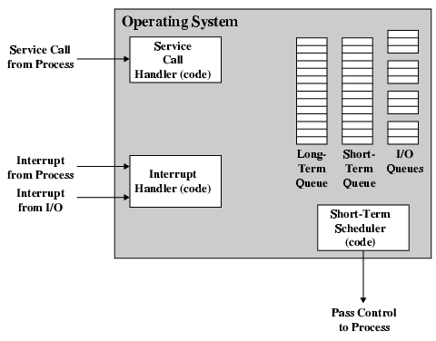
Key Elements of O/S

Slide 29
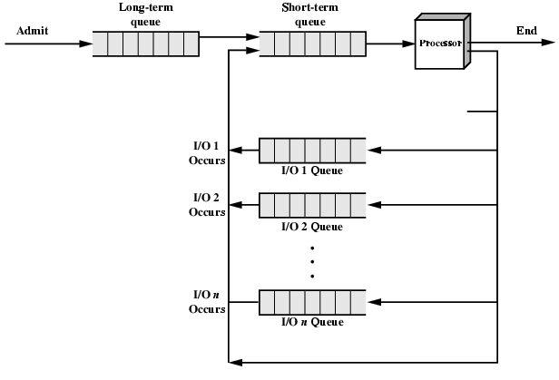
Process Scheduling

Slide 30
Memory Management
Uni-program
  Memory split into two
  One for Operating System (monitor)
  One for currently executing program
Multi-program
  “User” part is sub-divided and shared among active processes

Slide 31
Swapping
Problem: I/O is so slow compared with CPU that even in multi-programming system, CPU can be idle most of the time
Solutions:
  Increase main memory
    Expensive
    Leads to larger programs
  Swapping

Slide 32
What is Swapping?
Long term queue of processes stored on disk
Processes “swapped” in as space becomes available
As a process completes it is moved out of main memory
If none of the processes in memory are ready (i.e. all I/O blocked)
  Swap out a blocked process to intermediate queue
  Swap in a ready process or a new process
  But swapping is an I/O process…

Slide 33
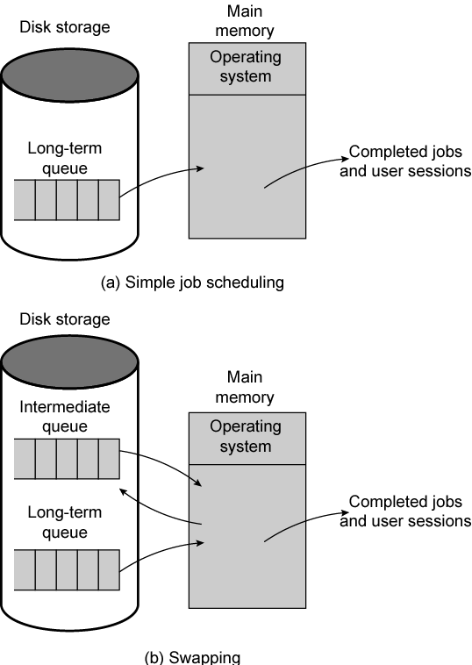
Use of Swapping

Slide 34
Partitioning
Splitting memory into sections to allocate to processes (including Operating System)
Fixed-sized partitions
  May not be equal size
  Process is fitted into smallest hole that will take it (best fit)
  Some wasted memory
  Leads to variable sized partitions

Slide 35
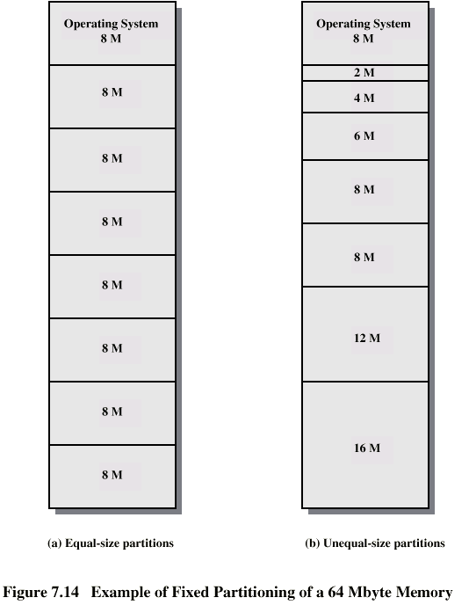
Fixed
Partitioning

Slide 36
Variable Sized Partitions (1)
Allocate exactly the required memory to a process
This leads to a hole at the end of memory, too small to use
  Only one small hole - less waste
When all processes are blocked, swap out a process and bring in another
New process may be smaller than swapped out process
Another hole

Slide 37
Variable Sized Partitions (2)
Eventually have lots of holes (fragmentation)
Solutions:
  Coalesce - Join adjacent holes into one large hole
  Compaction - From time to time go through memory and move all hole into one free block (c.f. disk de-fragmentation)

Slide 38
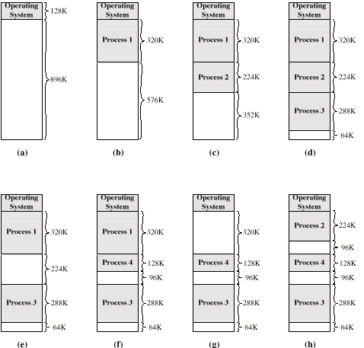
Effect of Dynamic Partitioning

Slide 39
Relocation
No guarantee that process will load into the same place in memory
Instructions contain addresses
  Locations of data
  Addresses for instructions (branching)
Logical address - relative to beginning of program
Physical address - actual location in memory (this time)
Automatic conversion using base address

Slide 40
Paging
Split memory into equal sized, small chunks -page frames
Split programs (processes) into equal sized small chunks - pages
Allocate the required number page frames to a process
Operating System maintains list of free frames
A process does not require contiguous page frames
Use page table to keep track

Slide 41
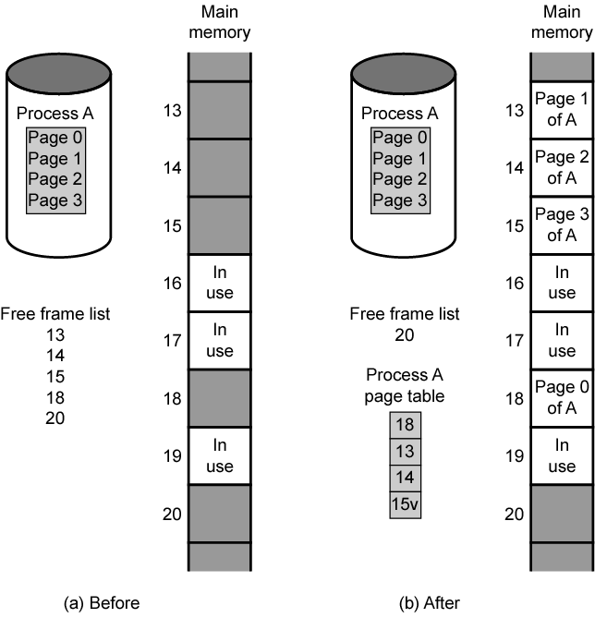
Allocation of Free Frames

Slide 42
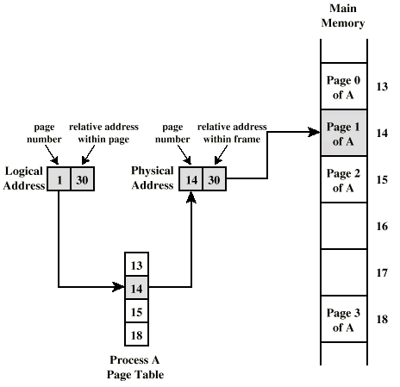
Logical and Physical Addresses - Paging

Slide 43
Virtual Memory
Demand paging
  Do not require all pages of a process in memory
  Bring in pages as required
Page fault
  Required page is not in memory
  Operating System must swap in required page
  May need to swap out a page to make space
  Select page to throw out based on recent history

Slide 44
Thrashing
Too many processes in too little memory
Operating System spends all its time swapping
Little or no real work is done
Disk light is on all the time
Solutions
  Good page replacement algorithms
  Reduce number of processes running
  Fit more memory

Slide 45
Bonus
We do not need all of a process in memory for it to run
We can swap in pages as required
So - we can now run processes that are bigger than total memory available!
Main memory is called real memory
User/programmer sees much bigger memory - virtual memory

Slide 46
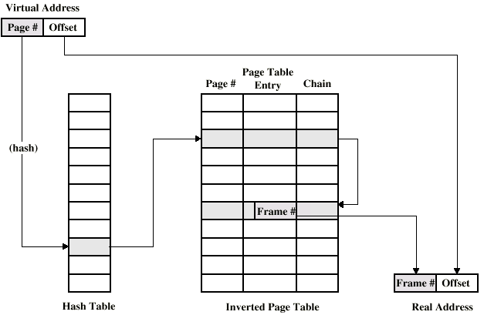
Inverted Page Table Structure

Slide 47
Translation Lookaside Buffer
Every virtual memory reference causes two physical memory access
  Fetch page table entry
  Fetch data
Use special cache for page table
  TLB

Slide 48
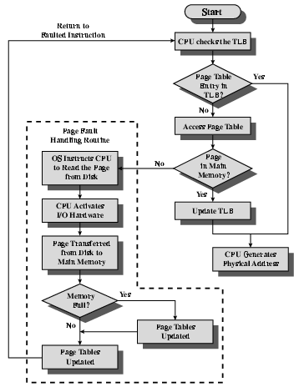
TLB Operation

Slide 49
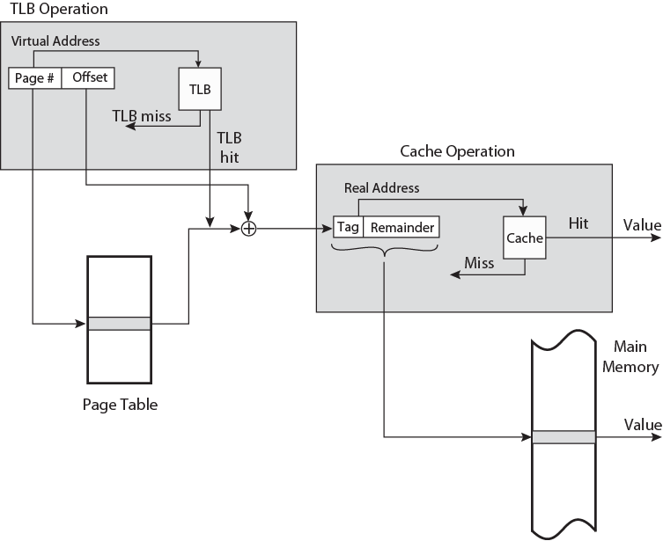
TLB and Cache Operation

Slide 50
Segmentation
Paging is not (usually) visible to the programmer
Segmentation is visible to the programmer
Usually different segments allocated to program and data
May be a number of program and data segments

Slide 51
Advantages of Segmentation
Simplifies handling of growing data structures
Allows programs to be altered and recompiled independently, without re-linking and re-loading
Lends itself to sharing among processes
Lends itself to protection
Some systems combine segmentation with paging

Slide 52
Pentium II
Hardware for segmentation and paging
Unsegmented unpaged
  virtual address = physical address
  Low complexity
  High performance
Unsegmented paged
  Memory viewed as paged linear address space
  Protection and management via paging
  Berkeley UNIX
Segmented unpaged
  Collection of local address spaces
  Protection to single byte level
  Translation table needed is on chip when segment is in memory
Segmented paged
  Segmentation used to define logical memory partitions subject to access control
  Paging manages allocation of memory within partitions
  Unix System V

Slide 53
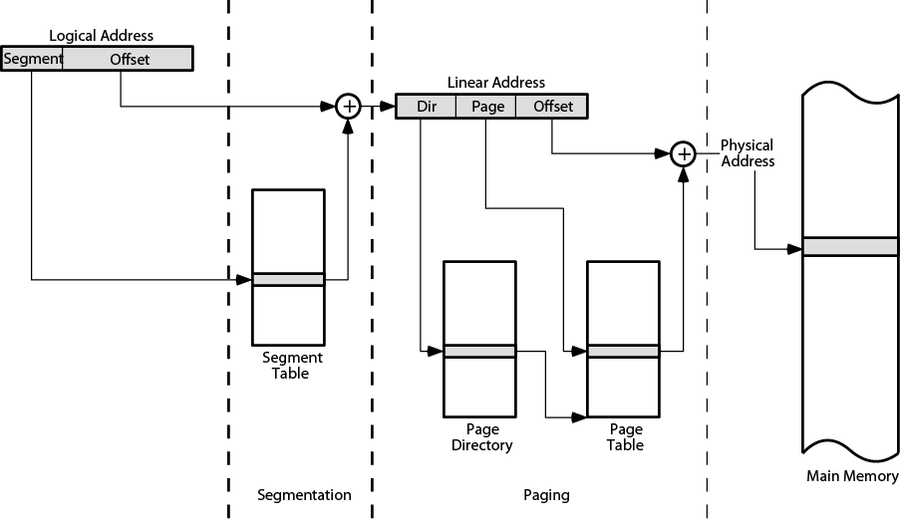
Pentium II Address Translation Mechanism

Slide 54
Pentium II Segmentation
Each virtual address is 16-bit segment and 32-bit offset
2 bits of segment are protection mechanism
14 bits specify segment
Unsegmented virtual memory 2³² = 4Gbytes
Segmented 2⁴⁶=64 terabytes
  Can be larger – depends on which process is active
  Half (8K segments of 4Gbytes) is global
  Half is local and distinct for each process

Slide 55
Pentium II Protection
Protection bits give 4 levels of privilege
  0 most protected, 3 least
  Use of levels software dependent
  Usually level 3 for applications, level 1 for O/S and level 0 for kernel (level 2 not used)
  Level 2 may be used for apps that have internal security e.g. database
  Some instructions only work in level 0

Slide 56
Pentium II Paging
Segmentation may be disabled
  In which case linear address space is used
Two level page table lookup
  First, page directory
    1024 entries max
    Splits 4G linear memory into 1024 page groups of 4Mbyte
    Each page table has 1024 entries corresponding to 4Kbyte pages
    Can use one page directory for all processes, one per process or mixture
    Page directory for current process always in memory
  Use TLB holding 32 page table entries
  Two page sizes available 4k or 4M

Slide 57
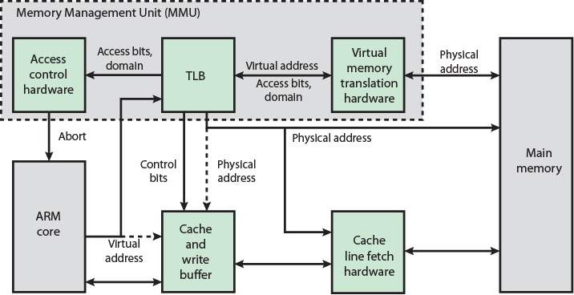
ARM Memory System Overview

Slide 58
ARM Memory Management
Virtual memory translation
  One or two levels of tables
Translation lookaside buffer (TLB)
  Cache of recent entries
  If available, TLB directly sends physical address to main memory
Data exchanged between processor and main memory via cache
Logical cache organization
  On cache miss, ARM supplies address directly to cache as well as TLB
Physical cache organization
  TLB must supply physical address to cache
Access control bits also in translation tables

Slide 59
Virtual Memory Address Translation
Memory access based on either sections or pages
Supersections (optional)
  16-MB blocks of main memory
Sections
  1-MB blocks of main memory
Large pages
  64-KB blocks of main memory
Small pages
  4-KB blocks of main memory
Sections and supersections allow mapping of large region of memory with single TLB entry
Additional access control mechanisms
  Small pages use 1KB subpages
  Large pages use 16KB subpages
Two level translation table held in main memory
  First-level table holds section and supersection translations, and pointers to second-level tables
  Second-level tables: Hold both large and small page translations
MMU
  Translates virtual to physical addresses
  Derives and checks access permission
  After TLB miss
Start with first-level fetch
  Section-mapped access only requires first-level fetch
  Page-mapped access requires second-level fetch

Slide 60
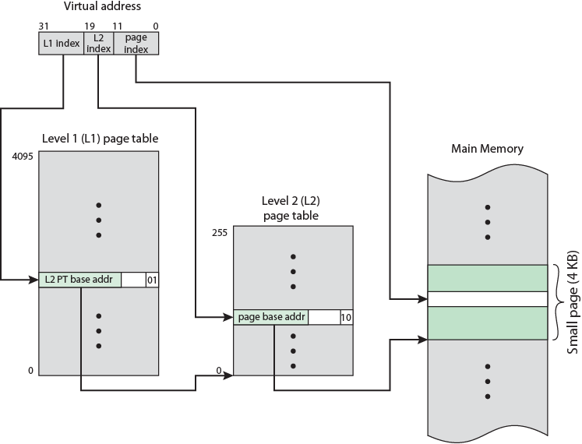
ARM Virtual Memory Address Translation for Small Pages - Diagram

Slide 61
ARM Virtual Memory Address Translation for Small Pages
Single L1 page table
  4K 32-bit entries
  Each L1 entry points to L2 page table
Each L2 page table
  255 32-bit entries
  Each L2 entry points to 4-KB page in main memory
32-bit virtual address
  Most significant 12 bits index L1 page table
  Next 8 bits index relevant L2 page table
  Least significant 12 bits index a byte in relevant main memory page
Similar procedure for large pages
Sections and supersection only use L1 page table

Slide 62
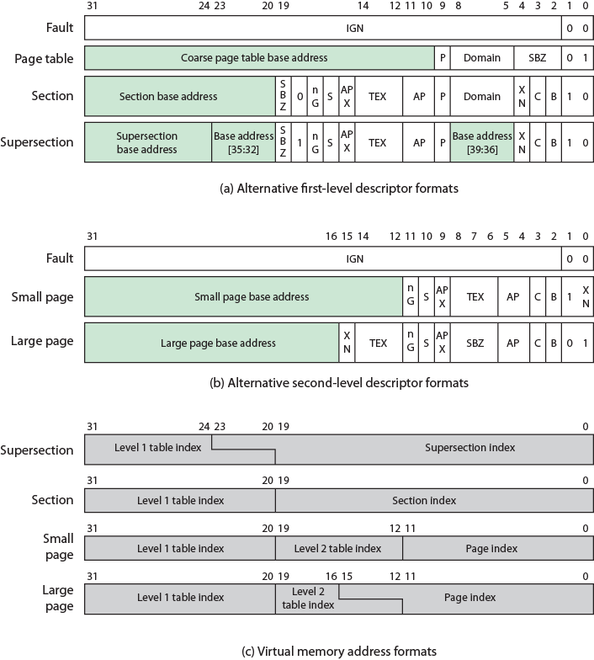
ARMv6
Memory
Management
Formats

Slide 63
ARM Memory-Management Parameters
Access Permission (AP), Access Permission Extension (APX)
  Control access to corresponding memory region
  Access without required permissions raises Permission Fault
Bufferable (B) bit
  With TEX bits, how write buffer is used
Cacheable (C) bit
Can memory region be mapped through cache?
Domain
  Collection of memory regions
  Access control can be applied on the basis of domain
not Global (nG)
  Translation marked as global (0), or process specific (1)?
Shared (S)
  Translation is for not-shared (0), or shared (1) memory?
SBZ
  Should be zero
Type Extension (TEX)
  Together with B and C bits, control accesses to caches
  How write buffer is used
  If memory region is shareable
    Must be kept coherent
Execute Never (XN)
  Region is executable (0) or not executable (1)?

Slide 64
Memory Management Formats – L1 table
L1 table
  Entry describes how associated 1-MB virtual address range is mapped
Bits [1:0] = 00
  Virtual addresses unmapped
  Attempts to access generate translation fault
Bits [1:0] = 01
  Physical address of L2 page table which specifies how associated virtual address range is mapped
Bits [1:0] = 01 and bit 19 = 0
  Section descriptorBits [1:0] = 01 and bit 19 = 1
  Supersection descriptor
Entries with bits [1:0] = 11
  Reserved

Slide 65
L2 Table
Small and Large Pages
For memory structured into pages
L1 page entry bits [31:10] point to a L2 page table
Small pages
  L2 entry holds 20-bit pointer to base address of 4-KB page in main memory
Large pages
  Virtual address includes 12-bit index to L1 table and an 8-bit index to L2 table
  64-KB large pages have 16 bit page index portion
  Four-bit overlap between page index field and L2 table index field
  Page table entries in L2 page table replicated 16 times
  L2 page table reduced from 256 entries to 16 if all refer to large pages
  L2 page can service mixed large and small pages

Slide 66
L2 Table
Sections and Supersections
Sections or supersections
  One-level page table access
Sections
  L1 entry Bits [31:20] hold 12-bit pointer to 1-MB section
For supersections
  L1 bits [31:24] hold 8-bit pointer to base of the 16-MB section
Page table entry replication is required
  Supersections L1 table index portion of virtual address overlaps 4 bits with supersection index portion of virtual address
  16 identical L1 page table entries
Physical address space can be expanded by up to eight additional address bits
  Bits [23:20] and [8:5]
  Implementation dependent
  Interpreted as extending physical memory by up to 2⁸ = 256
  Physical memory may be up to 256 times memory space available to each individual process

Slide 67
Access Control
Region of memory can be designated as no access, read only, or read/write
Region can be designated privileged access (operating Systems) only
Domain
  Collection of sections and/or pages with particular access permissions
  16
  Multiple processes can use same translation tables while maintaining some protection from each other
  Page table entry and TLB entry contain domain field
  Two-bit field in the Domain Access Control Register controls access to each domain
  Whole memory areas can be swapped very efficiently
Clients
  Must observe permissions of individual sections and/or pages in domain
Managers
  Control domain behavior
    Sections and pages in domain access
    Bypass access permissions for table entries in domain
Programs can be
  Client of some domains
  Manager of other domains
  No access to remaining domains

Slide 68
Required Reading
Stallings chapter 8
Stallings, W. [2004] Operating Systems, Pearson
Loads of Web sites on Operating Systems

